Slide 1
Electricity Price Prediction
For Habo Plast
By ML Squad

Slide 2
Problem Statement:
Objective: Predict hourly electricity prices for Habo Plast for the upcoming week
Significance: Accurate forecasting help to manage operational expenses and also in better resource management.
Data Utilized:
Sweden’s Historical Weather Data: Extracted using the provided code file.
Day-Ahead Electricity Price Data: Supplied dataset.
Sweden’s Electricity Imports and Exports: Accessed via the Energy Chart API.
Additional data for further experimentation
Time Features – Weekends, Holidays, Lag features

Slide 3
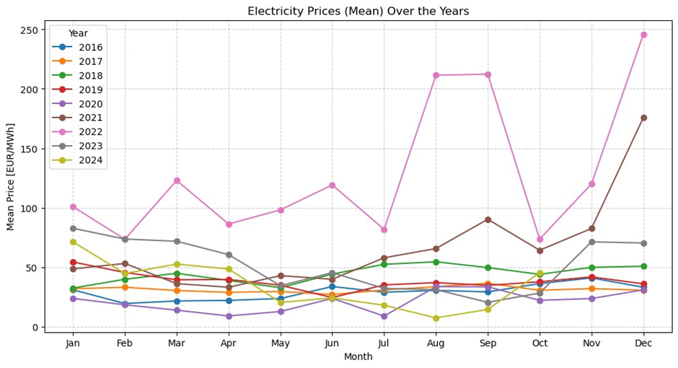
Data Preprocessing:
Handling missing values.
Mean/Sum imputation for weather parameters
Combining the datasets for analysis and model building

Slide 4
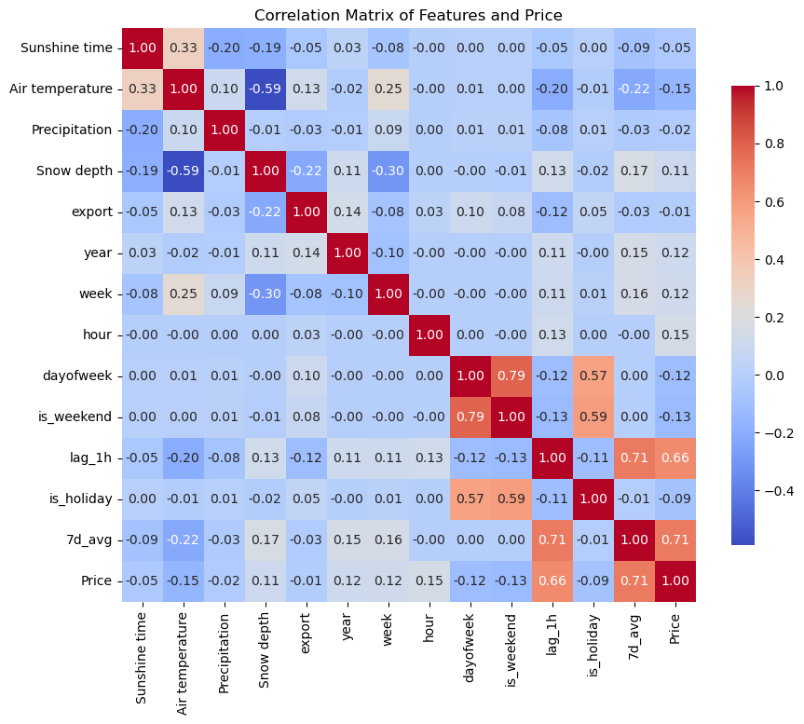
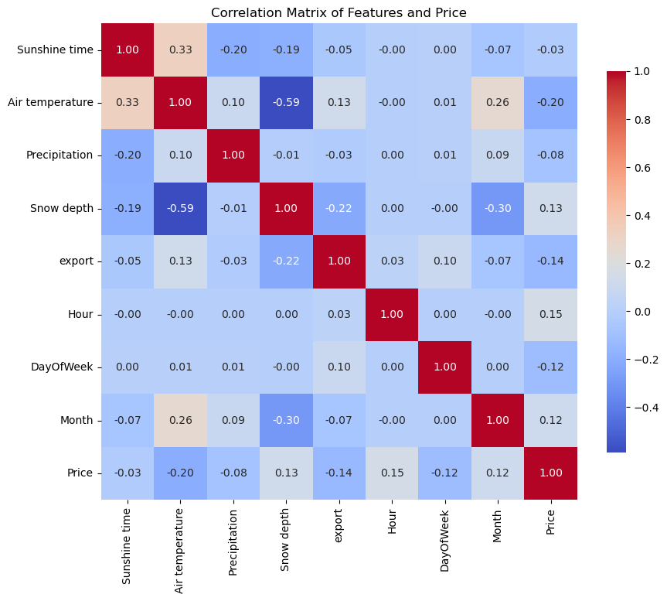
Feature Analysis and Selection
Normalizing features – Standard Scaler/Robust scaler
Feature selection using correlation analysis

Slide 5
Model Building
Implemented Models
Polynomial Regression
Random Forest Regression
XGBoost Regression
Artificial Neural Networks (ANN)

Slide 6
Approaches and Implementation
Hyperparameter tuning
Fine-tuning model hyperparameters for optimal performance.
10-Fold Cross Validation
Model evaluation by splitting data into multiple subsets.
Time Series Cross Validation
Handling temporal dependencies in the data.
Lag Features
Incorporating past data to capture dependencies and trends.

Slide 7
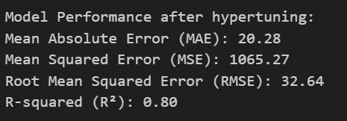
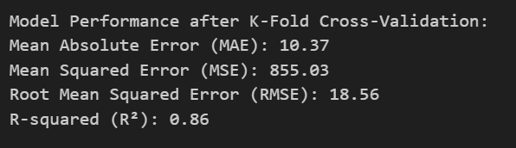
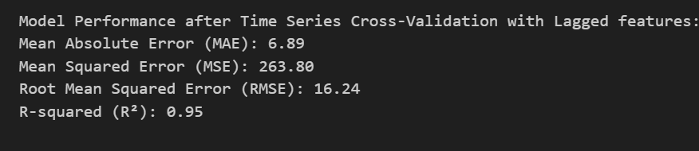
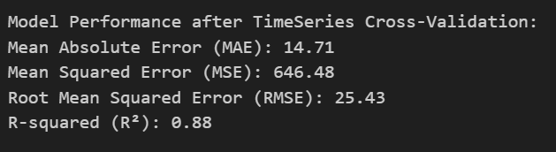
Model Performance - XGBoost

Slide 8
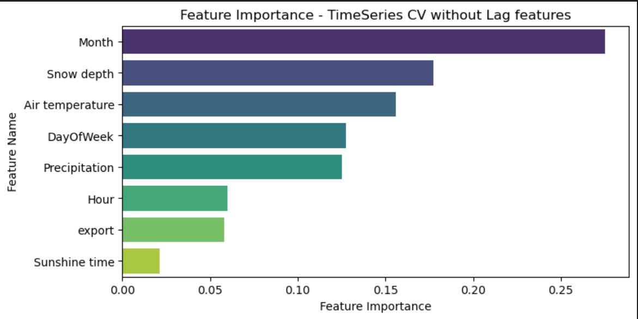
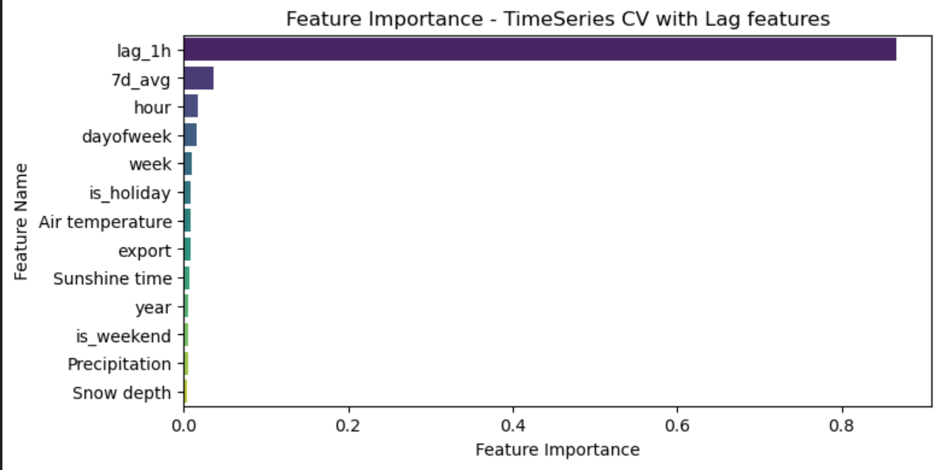
Feature Importance

Slide 9
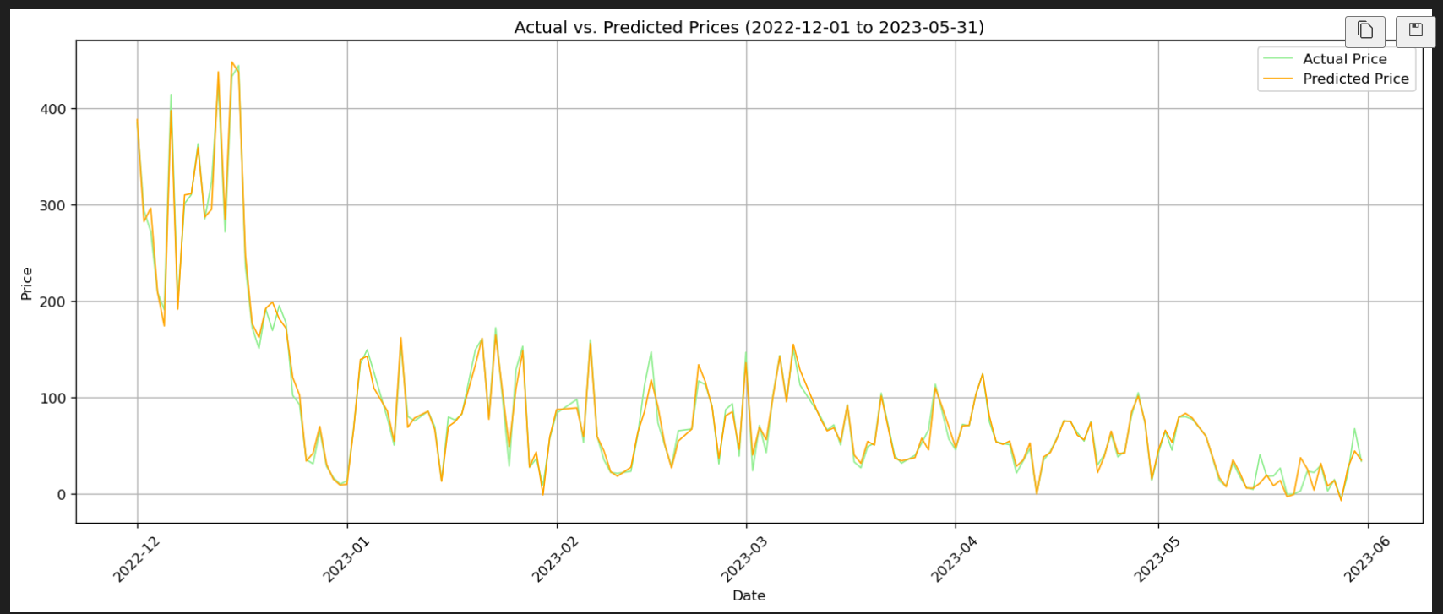
Actual Price vs Predicted Price Dec 2022 – May 2023

Slide 10
Evaluation Procedures (Merits)
R² | MSE | RMSE | MAE
Relative Performance Measure | Differentiable | Original Units : Easier Interpretation | Easier to Interpret
Independent Scale | Penalize Large Errors More | Penalize Large Errors | Robust to Outliers
Useful for Model Comparisons across Datasets | Useful when Large Errors are Costly | Balance between MAE and MSE | Useful for Cost Sensitive Applications
Notes:
Model Notes :
MAE
- Good for RF and XGB, not sensitive to error magnitude
- Works for ANN, but MSE is optimal
MSE
- Best for ANN
- May over-penalize outliers in RF and PR
RMSE
- Common for RF and XGB
- Good for time series forecasting
R2
- Useful for model comparison
- Can be low even if MAE/MSE is in acceptable range

Slide 11
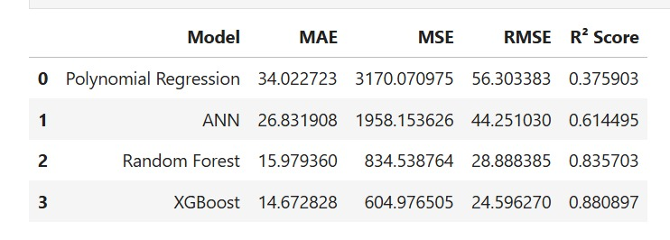
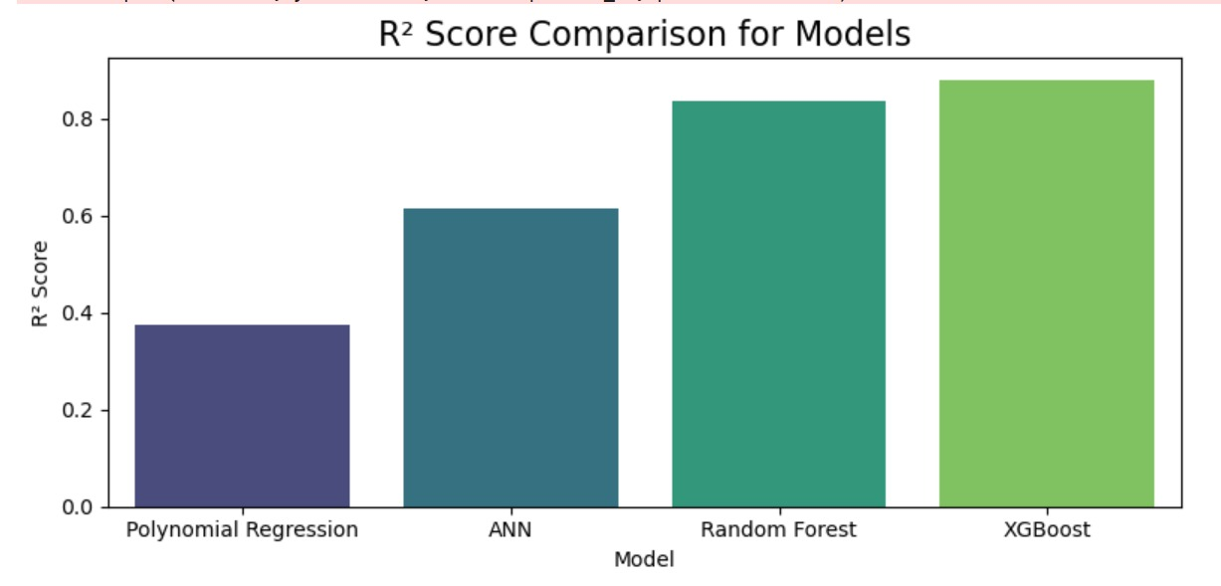
Evaluation Procedures (Demerits)
R² | MSE | RMSE | MAE
Misleading for Non-Linear or Non-Stationary data | Sensitive to Outliers | Sensitive to Outliers | Non-Differentiable At Zero
Doesn’t convey Absolute Error Magnitudes | Squared Units : Difficult to Interpret | Harder to Compute | Doesn’t Penalize Large Errors Heavily

Slide 12
Cross Validation Evaluations
Mean Absolute Error (Metrics):
Used for Assessing Model Accuracy
Best suited for Polynomial Regression, Random Forest, ANN and XGBoost
Easy to Interpret
Mean Squared Error (Loss Function):
Used to Optimize Model Parameters/Weights
Useful for forecasting Risk
Smoothens training process (especially for ANN)

Slide 13
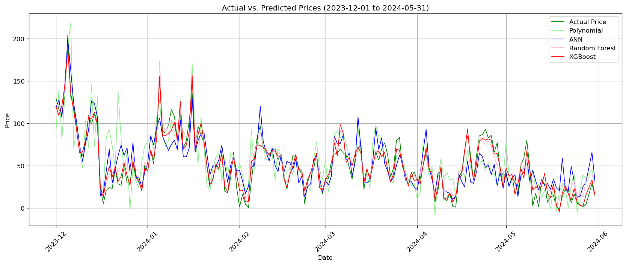
Results
All Model Comparisons
Lower Prediction Errors
Better Generalization
More Stable Performance
Handles Complexity Well
Efficiency in Learning
Best is XGBoost

Slide 14
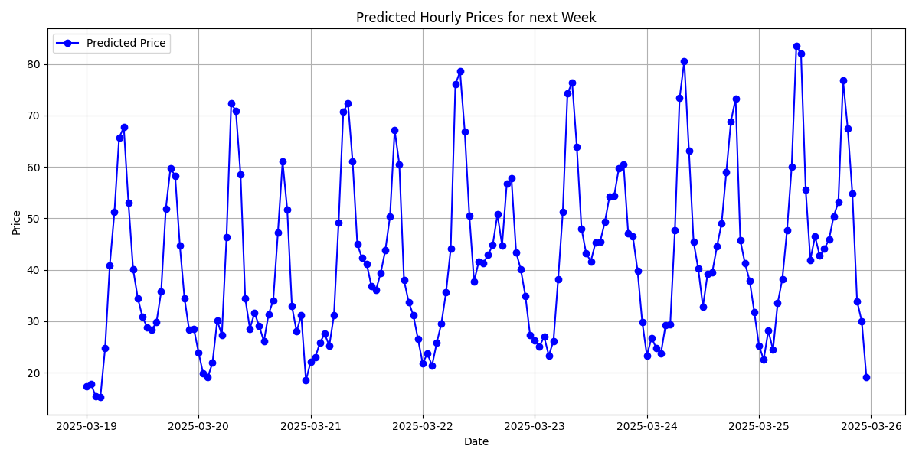
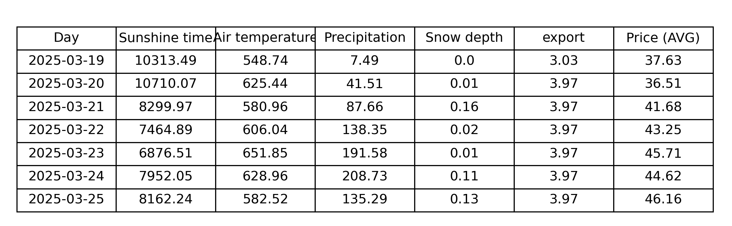
Predicted Future price using XGBoost
✅ Graph = Hourly price predictions (fluctuations throughout the day)
✅ Table = Daily average price (overall trend for each day)
✅ Hourly predictions help in understanding short-term trends, while daily averages provide a broader view of price movements.

Slide 15
Exploring the Result
Full Feature Forecasting with Multi-Output XGBoost
(Forecast Period: 3/19/2025 – 3/25/2025)
Data Preparation:
Load historical CSV (Date, Time, Sunshine, Air Temp, Precipitation, Snow Depth, Price).
Combine Date & Time, fill missing values, and scale data via MinMaxScaler.
Lagged Feature Engineering:
Use a 24-hour sliding window (24 hrs × 5 features = 120 inputs).
Forecast the next 168 hours for all features (168 hrs × 5 features = 840 outputs).
Model Training:
Train a MultiOutputRegressor wrapping XGBoost (n_estimators=100, max_depth=4).
Model learns mapping: 24 hrs history → 168 hrs forecast (all features).
Prediction Process:
Input: last 24 hours (scaled & flattened).
Predict one-shot 168-hour future vector, reshape & inverse scale.
Final Output:
Construct a DataFrame with Date, Time, Sunshine, Air Temp, Precipitation, Snow Depth, export (from API), & Price.
Save as full_forecast_all_features_xgb_3_19_to_3_25.csv.

Slide 16
Recommendations for future
ARIMA (p,d,q) ---capturing long-term trends
SARIMA (p,d,q)(P,D,Q,s) ---- seasonal patterns
LSTM --- handling long-term dependencies.

Slide 17
Hybrid Models
XGBoost + LSTM:
XGBoost for nonlinear relationships, LSTM for temporal dependencies
SARIMA + XGBoost:
SARIMA predicts the linear component and computes residuals,
and XGBoost models the residuals, capturing nonlinear effects
Ref:
[1] Manfre Jaimes, D., Zamudio López, M., Zareipour, H., & Quashie, M. (2023). A hybrid model for multi-day-ahead electricity price forecasting considering price spikes. Forecasting, 5(3), 499-521. https://doi.org/10.3390/forecast5030028
[2] Huang, S., Shi, J., Wang, B., An, N., Li, L., Hou, X., Wang, C., Zhang, X., Wang, K., Li, H., Zhang, S., & Zhong, M. (2024). A hybrid framework for day-ahead electricity spot-price forecasting: A case study in China. Applied Energy, 373, 123863. https://doi.org/10.1016/j.apenergy.2024.123863
[3] Bitirgen, K., & Başaran Filik, Ü. (2020). Electricity price forecasting based on XGBoost and ARIMA algorithms. ResearchGate.

Slide 18
Implementation
Resource requirement:
XGBoost is typically lightweight and easy to deploy, whereas LSTM may require more resources.
Time requirement:
Tester code: Take a few seconds you can get the predicted electricity price for the upcoming week

Slide 19
Thank you!

